Slide 1
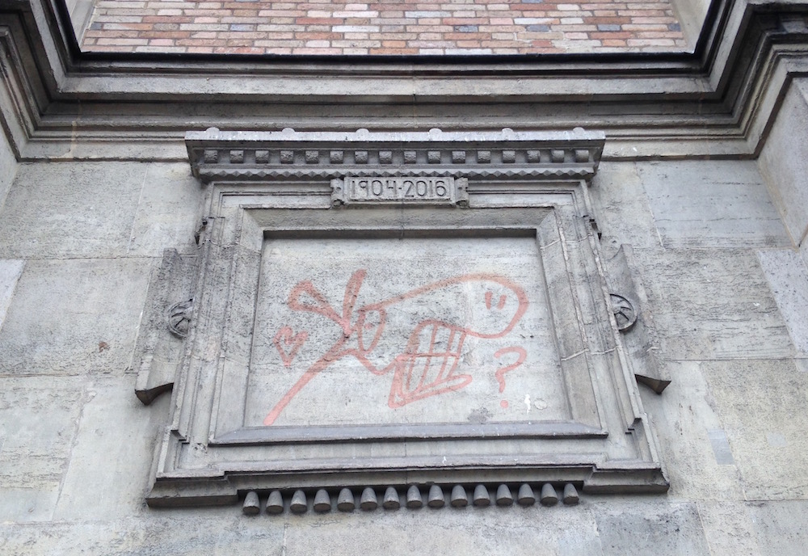
HORSE 2016
On “Horses” and “Potemkin Villages” in Applied Machine Learning

Slide 2
HORSE 2016
On “Horses” and “Potemkin Villages” in Applied Machine Learning

Slide 3

FIRE SAFETY

Slide 4
WELCOME
Premier edition!
Acknowledgments to the EPSRC Platform Grant on Digital Music (EP/K009559/1)
HORSE 2016 is co-organised by
Applied Machine Learning Lab http://machinelearning.eecs.qmul.ac.uk/
Machine Listening Lab http://machine-listening.eecs.qmul.ac.uk/

Slide 5
WELCOME
Thank you for attending!
It is a weird idea for a workshop.
And you get free coffee and lunch!
Thank you to all the contributors.

Slide 6
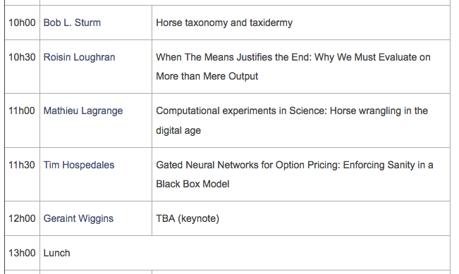
SCHEDULE, part 1

Slide 7
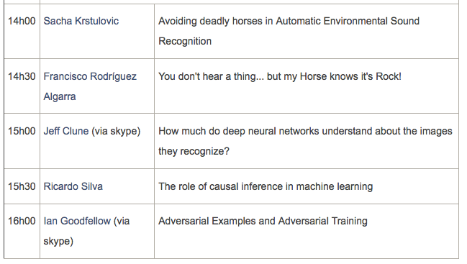
SCHEDULE, part 2
16h30 : Make our way to Half Moon Pub (Mile End Wetherspoons)

Slide 8
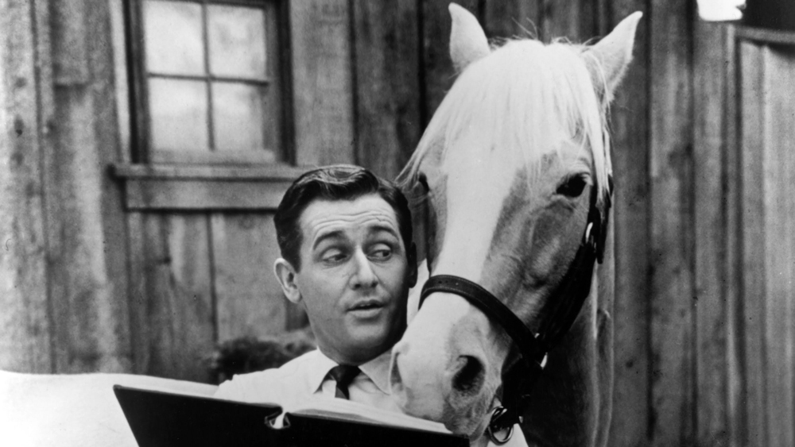
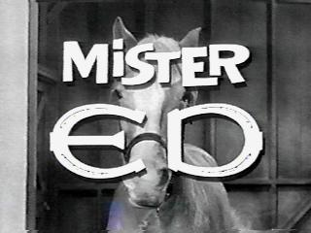
In memoriam, Ed Young (1919-2016)
1958-1966

Slide 9
“Horse” taxonomy and taxidermy
Bob L. Sturm

Slide 10
What is a “horse”?
“a ‘horse’ is just a system that is not actually addressing the problem it appears to be solving.”
Sturm, “A simple method to determine if a music information retrieval system is a ‘horse’,” IEEE Transactions Multimedia 16(6): 1636–1644, 2014.
Is a system giving the right answers for the right reasons?

Slide 11
Why is this important?
Applying machine learning and artificial intelligence within many domains requires transparency and responsibility!
health care
finance
surveillance
autonomous vehicles
government
“Why exactly was my loan application rejected?”
“What could I have done differently so that my application would not have been rejected?”

Slide 12

Why is this important?
J. Vincent, “First Click: Deep learning is creating computer systems we don't fully understand”, The Verge (July 12, 2016) http://www.theverge.com/2016/7/12/12158238/first-click-deep-learning-algorithmic-black-boxes
A. Das et al., “Human Attention in Visual Question Answering: Do Humans and Deep Networks Look at the Same Regions?”, 2016 http://arxiv.org/abs/1606.03556.
“Like good students, computers need to be able to show their working.”

Slide 13
Why is this important?
L. Alexander, “Is an algorithm any less racist than a human?”, The Guardian (Aug 3, 2016) https://www.theguardian.com/technology/2016/aug/03/algorithm-racist-human-employers-work
“Any algorithm can – and often does – simply reproduce the biases inherent in its creator, in the data it’s using, or in society at large.”
https://socialmediacollective.org/reading-lists/critical-algorithm-studies/#1.1
http://algorithmwatch.org/das-adm-manifest-the-adm-manifesto/#English

Slide 14
Why is this important?
T. O’Reilly, “The great question of the 21st century: Whose black box do you trust?”, linkedin.com (Sep 13, 2016) https://www.linkedin.com/pulse/great-question-21st-century-whose-black-box-do-you-trust-tim-o-reilly
“Understanding how to evaluate algorithms without knowing the exact rules they follow is a key discipline in today's world.”
Goodfellow et al., “Explaining and harnessing adversarial examples,” in Proc. ICLR, 2015.
Yosinski, Clune, et al., “Understanding Neural Networks Through Deep Visualization,” ArXiv e-prints, June 2015.
Ribeiro et al., “’Why should I trust you?’: Explaining the predictions of any classifier,” in Proc. ACM SIGKDD Int. Conf. Knowledge Discovery and Data Mining, 2016.

Slide 15
Why is this important?
K. Wagstaff, “Machine learning that matters”, in Proc. ICML , 2012.
“Many machine learning problems are phrased in terms of an objective function to be optimized. It is time for us to ask a question of larger scope: what is the field’s objective function? Do we seek to maximize performance on isolated data sets? Or can we characterize progress in a more meaningful way that measures the concrete impact of machine learning innovations?”
http://www.wkiri.com/mlimpact/

Slide 16
On Taxonomy

Slide 17
On taxonomy
A “horse” is just a system that is not actually addressing the problem it appears to be solving.
A system is a “horse” only in relation to a specific problem.
A “horse” for one problem may not be a “horse” for another
“Reproduce ground truth by XYZ” vs. “Reproduce ground truth by any means”
It is us humans who infer a relationship between a system and a problem.
Why, “horse?”

Slide 18
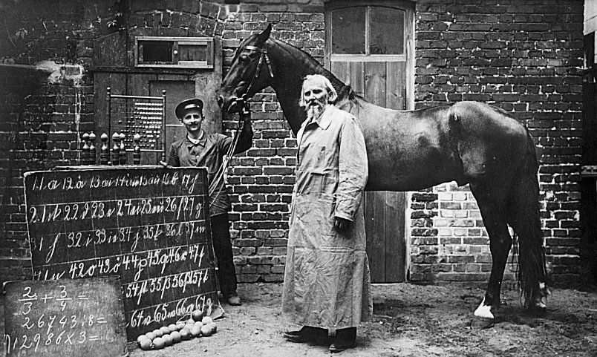
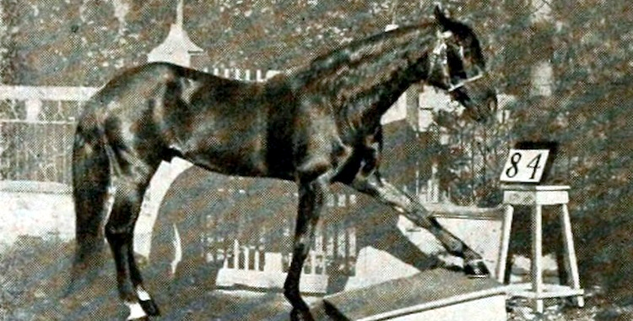
Clever Hans: A Model Metaphor
… but also a true life story!

Slide 19
Clever Hans: A Model Metaphor
… but also a true life story!

Slide 20
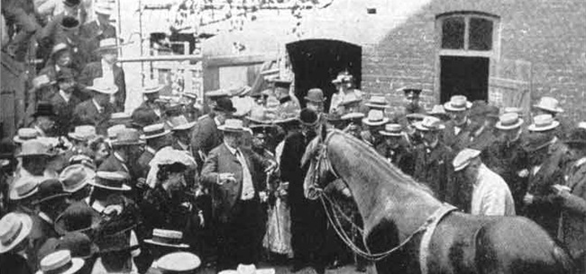
Clever Hans: A Model Metaphor
… but also a true life story!

Slide 21
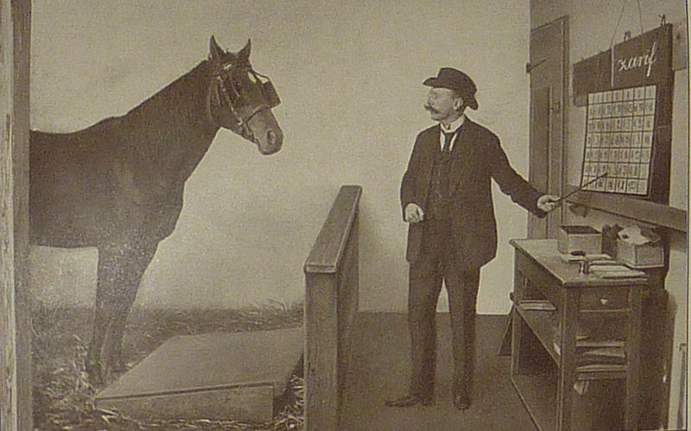
Clever Hans: A Model Metaphor
… but also a true life story!

Slide 22
Other possible metaphors
“Potemkin village”
Goodfellow et al., “Explaining and harnessing adversarial examples,” in Proc. ICLR, 2015.
Good figures of merit can be an illusion.
“Golem” (not Smeagol)
R. McElreath, Statistical Rethinking: A Bayesian Course with Examples in R and Stan, CRC Press, 2016.
Statistical tools are powerful but lack wisdom.
I argue that Clever Hans is a very appropriate metaphor, and also provides a useful methodology.

Slide 23
Similarities
von Osten believed he had taught Hans the concept of numbers
Used a strict pedagogical method
Hans was also allowed time in the pasture to think, and “discover many things for himself”
Hans could correctly answer unique questions
Many sincerely believe that they have taught a machine a particular concept because …
The dataset is big, carefully constructed, etc.
It performs significantly better than random for unique problems
Machine learning is well-established, theoretically grounded, successful in many domains

Slide 24
Similarities
Observers of Clever Hans did not think that each question could be asking something other than what was intended.
“How much is 2+3?” -> “Carrot for tapping your hoof until I raise.”
Many do not think that their dataset observations could be encoding something other than what they intend.
There can be many ways to reproduce the ground truth of a dataset.
Just because system performance is inconsistent with that expected of a random one does not mean it is likely to have learned the intended concept! (Today we will see several examples.)

Slide 25
Clever Hans presents a methodology too!
Pfungst recongised that asking Hans more of the same kind of questions does not measure his arithmetic abilities.
Instead, he controlled the experimental conditions to answer:
Does Hans really possess arithmetic acumen?
If not, then how does he appear to?
I will discuss two kinds of experiments inspired by Pfungst that get to the matter of determining system success.
Does a system really possess an understanding of the concept? (Is it giving the right answer for the right reasons?)
If not, then how does it appear to?

Slide 26
Is “horse” appropriate?
Some have said that the “horse” metaphor misunderstands the fundamentals of supervised machine learning
E.g., I am expecting too much, I am fighting straw men, etc.
What is the supervised machine learning doing?
Estimating a joint probability distribution from a labeled dataset
It is not equipped to tease out causal relationships, or judge relevance
Yet we see these kind of claims all the time:
“System ABC performs significantly better than random, and so recognises QRS.”
“We find that feature XYZ is important for recognising QRS.”

Slide 27
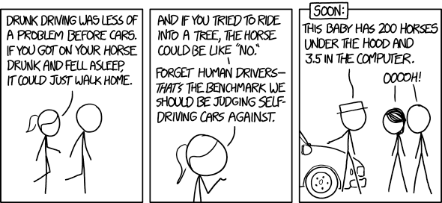
http://xkcd.com/1720/

Slide 28
“Horse” is appropriate
The metaphor of Clever Hans combines system and researcher.
von Osten et al. claimed remarkable things of his horse
Pfungst tested the claims in properly controlled and relevant ways
Clever Hans also shows why bigger data doesn’t necessarily solve the problem. It is about designing relevant experiments.
Seeking to know why a system behaves the way it does also addresses questions about its generalisation for a given problem --- a principal aim of machine learning.

Slide 29
An example “horse”

Slide 30
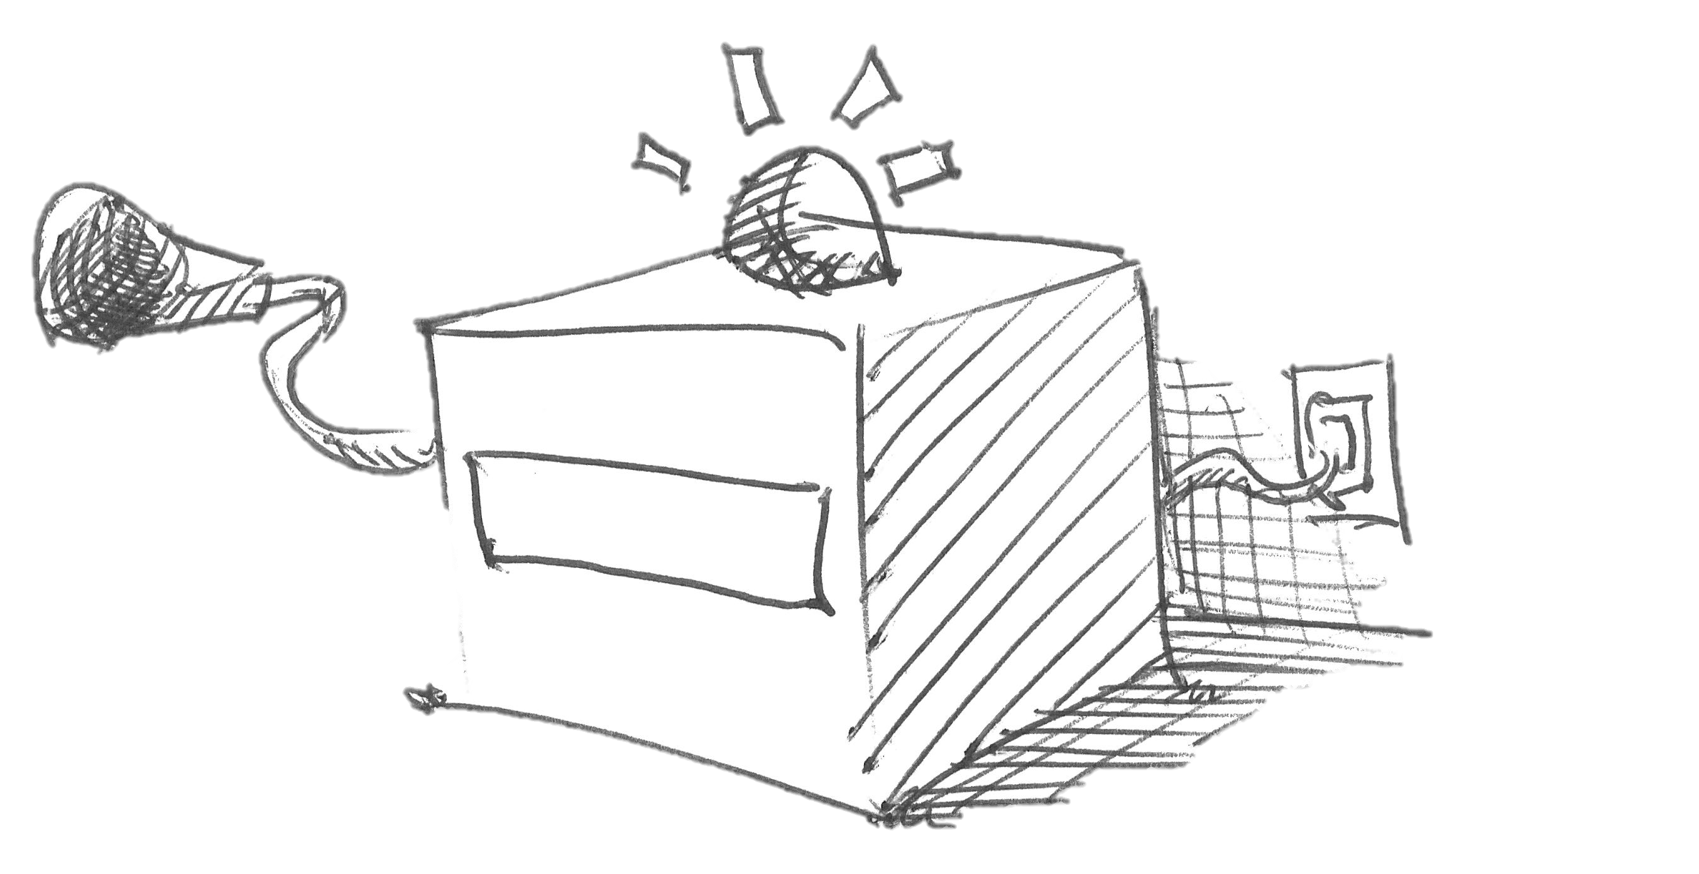
A music rhythm recognition system
Amplitude envelope periodicities over 10 s
Deep neural network
91% train/test accuracy in 7 rhythm classes
TANGO
Sturm, Kereliuk, and Pikrakis, “A closer look at deep learning neural networks with low-level spectral periodicity features,” in Proc. Int. Workshop on Cognitive Info. Process., 2014.

Slide 31
Does this system really know how to identify and discriminate between:
Cha cha cha
Jive
Quickstep
Rumba
Samba
Tango
Waltz
Will this system be useful to someone seeking rhythm information about a music recording?

Slide 32

An intervention experiment
RUMBA
Sturm, Kereliuk, and Pikrakis, “A closer look at deep learning neural networks with low-level spectral periodicity features,” in Proc. Int. Workshop on Cognitive Info. Process., 2014.

Slide 33
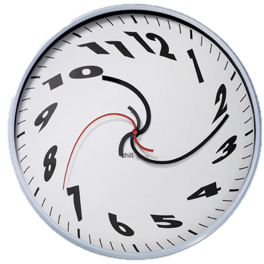
An intervention experiment
WALTZ
TIME DILATION
INTERVENTION
Sturm, Kereliuk, and Pikrakis, “A closer look at deep learning neural networks with low-level spectral periodicity features,” in Proc. Int. Workshop on Cognitive Info. Process., 2014.

Slide 34
Intervention Results
Sturm, Kereliuk, and Pikrakis, “A closer look at deep learning neural networks with low-level spectral periodicity features,” in Proc. Int. Workshop on Cognitive Info. Process., 2014.

Slide 35
A music rhythm recognition system
Useful?
Amplitude periodicities
Deep neural network
91% train/test accuracy in 7 rhythm classes
TANGO
Sturm, Kereliuk, and Pikrakis, “A closer look at deep learning neural networks with low-level spectral periodicity features,” in Proc. Int. Workshop on Cognitive Info. Process., 2014.

Slide 36
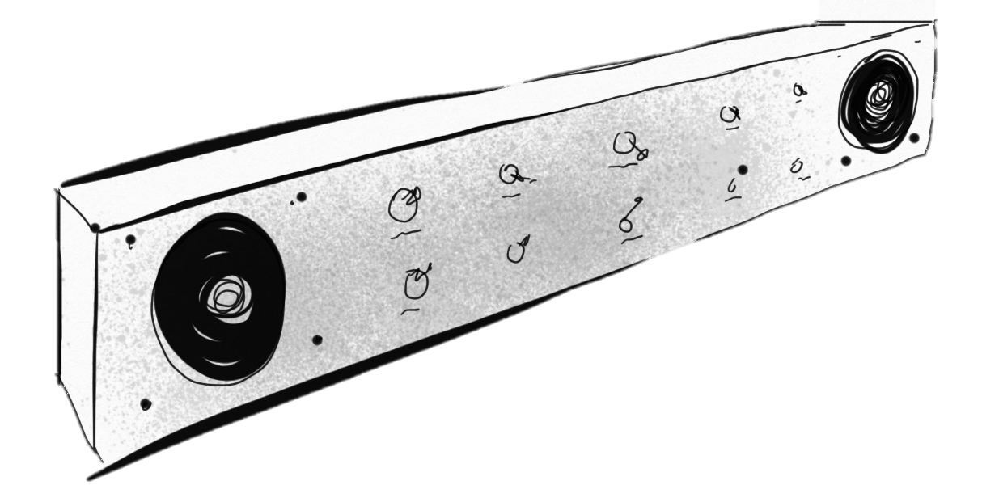
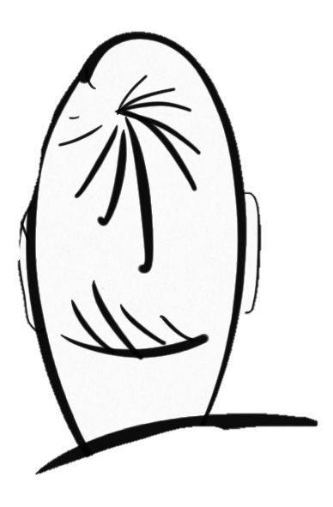
A generation experiment
MUSIC GENERATOR
XYZ 0.99
HUMAN
Can this human guess XYZ?
Sturm, “Two systems for automatic music genre recognition: What are they really recognizing?,” in Proc. ACM MIRUM Workshop, 2012.

Slide 37
Guess the rhythm
Cha cha cha
Jive
Quickstep
Rumba
Samba
Tango
Waltz
“???”
“???”
Sturm, “The “horse” inside: Seeking causes of the behaviours of music content analysis systems,” ACM Computers in Entertainment (accepted), 2016.

Slide 38
Guess the rhythm
Cha cha cha
Jive
Quickstep
Rumba
Samba
Tango
Waltz
“Tango”
“Waltz”
Sturm, “The “horse” inside: Seeking causes of the behaviours of music content analysis systems,” ACM Computers in Entertainment (accepted), 2016.

Slide 39
A music rhythm recognition system
Amplitude envelope periodicities over 10 s
Deep neural network
91% train/test accuracy in 7 rhythm classes
TANGO
Sturm, Kereliuk, and Pikrakis, “A closer look at deep learning neural networks with low-level spectral periodicity features,” in Proc. Int. Workshop on Cognitive Info. Process., 2014.

Slide 40
A music rhythm recognition system
How?
Amplitude envelope periodicities over 10 s
Deep neural network
91% train/test accuracy in 7 rhythm classes
TANGO
Sturm, Kereliuk, and Pikrakis, “A closer look at deep learning neural networks with low-level spectral periodicity features,” in Proc. Int. Workshop on Cognitive Info. Process., 2014.

Slide 41
One lurking cue
Sturm, Kereliuk, and Pikrakis, “A closer look at deep learning neural networks with low-level spectral periodicity features,” in Proc. Int. Workshop on Cognitive Info. Process., 2014.

Slide 42
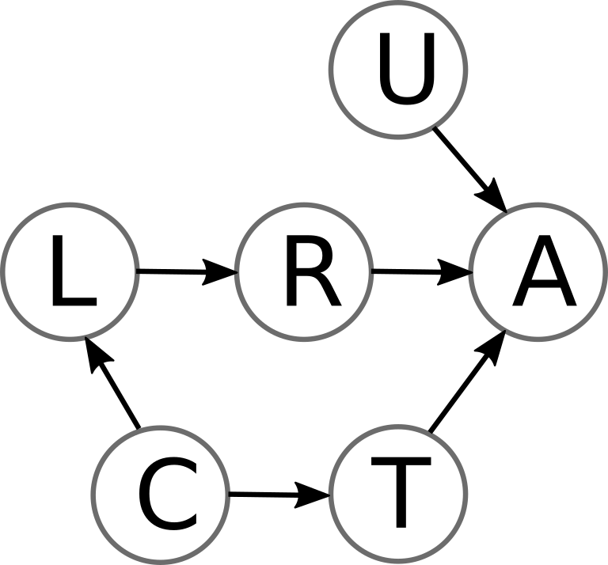
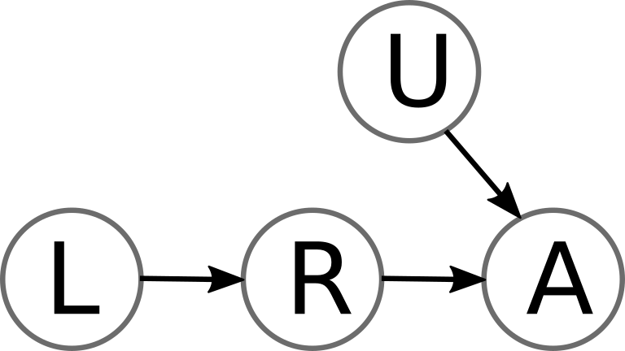
Machines learn the darndest things!
INTENDED
PROBLEM
ALTERNATE ROUTE

Slide 43
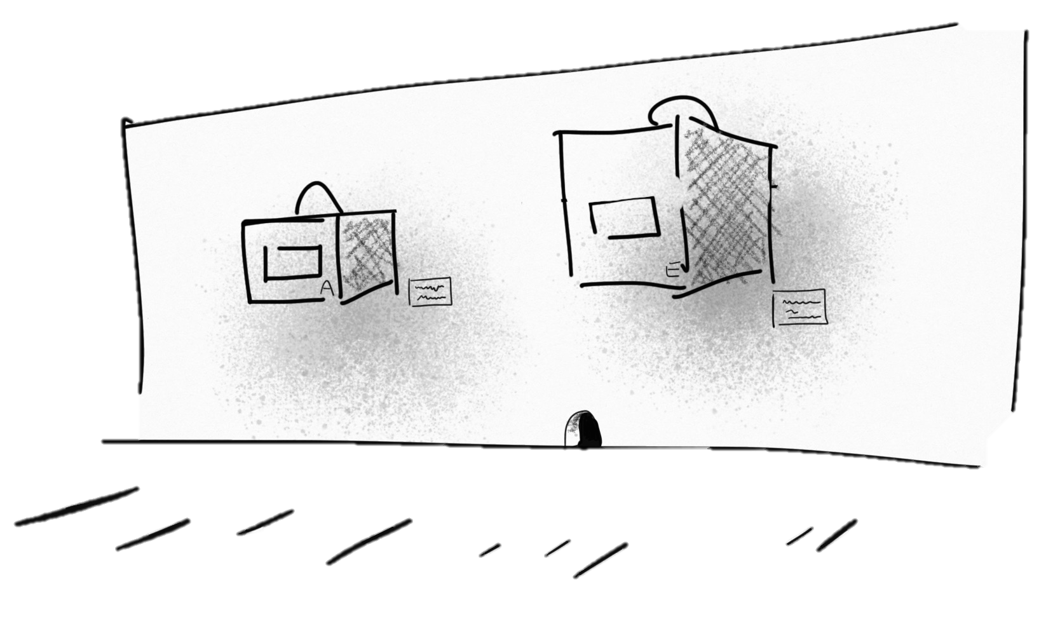
On Taxidermy

Slide 44
On Taxidermy
What should you do upon discovering a system to be giving the right answers for the wrong reasons?
You have uncovered valuable information to improve a system, its training, our datasets, etc.
Publish your findings with reproducible code.
Examples: http://www.eecs.qmul.ac.uk/~sturm/software/
A pessimist would call Pfungst’s work a “negative result”, but it is one of the greatest contributions to modern scientific methodology.
O. Pfungst, Clever Hans (The horse of Mr. Von Osten): A contribution to experimental animal and human psychology. New York: Henry Holt, 1911.

Slide 45
On Taxidermy
What should you do when someone discovers your system to be a “horse”?
Don’t take it personally
Celebrate! They have uncovered useful information to improve your system, its training, our datasets, and moving forward.
Collaborate to build a better system.
The default position for any machine learning system is, “horse” until proven otherwise.
Don’t stop at the cross-validation accuracies, confusions, etc.
Work to explain what the system has actually learned to do.

Slide 46
HORSE 2016
Clever Hans revealed to be a “horse”
1st year of HORSE!
On “Horses” and “Potemkin Villages” in Applied Machine Learning

